Slide 1
Data oriented job submission scheme for the PHENIX user analysis in CCJ
Tomoaki Nakamura, Hideto En’yo,
Takashi Ichihara, Yasushi Watanabe
and Satoshi Yokkaichi
RIKEN Nishina Center for Accelerator-Based Science

Slide 2
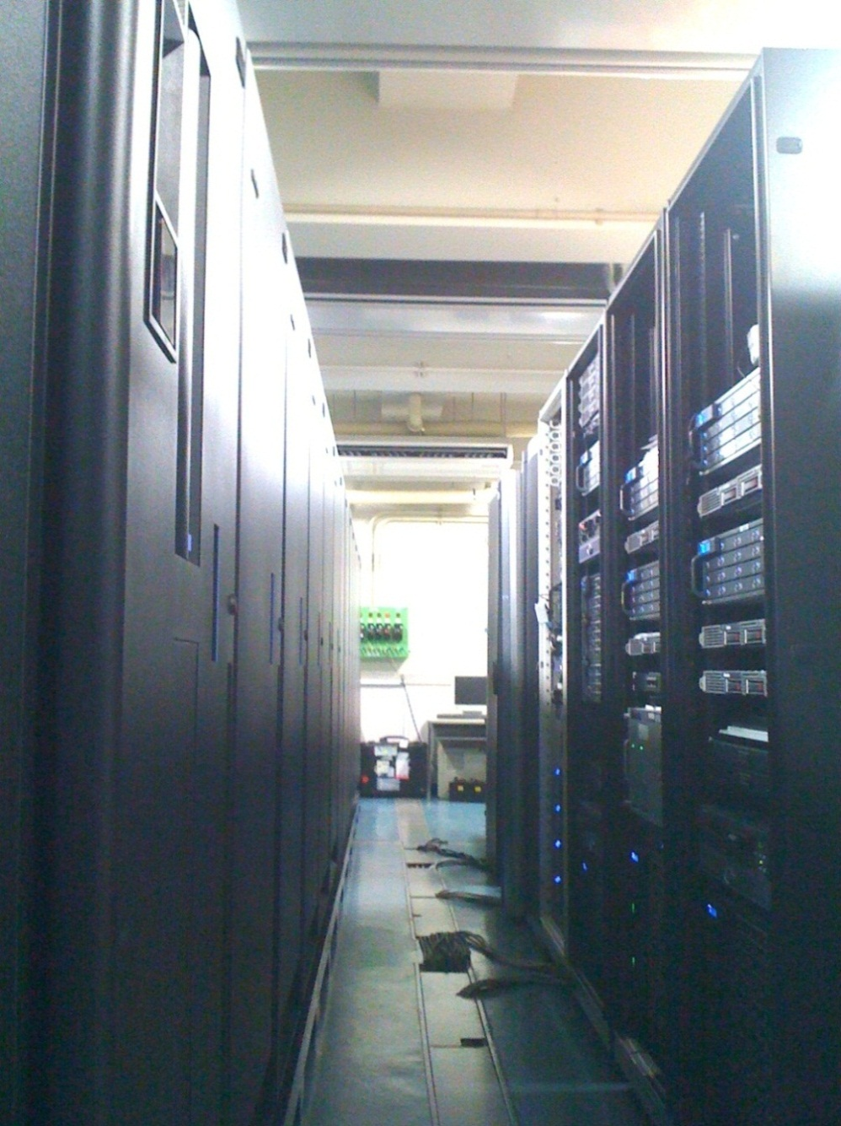
PHENIX Computing Center in Japan (CCJ)
CCJ history:
Developed since 1998 as regional analysis center for PHENIX and other RIKEN related experiments.
Construction was started at 1999.
Operation was started from 2000.
23 publications and ~30 doctoral dissertations have been completed by using CCJ resources.
PHENIX:
DST production (polarized p+p).
User level data analysis (p+p, A+A).
Detector analysis, calibrations.
MC simulations.
Detector R&D.
Other experiments:
KEK-PS E325, E559, Belle.
J-PARC, E16, E26, g-2.
Disk storage
and PC node
Tape robot

Slide 3
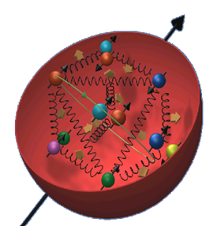
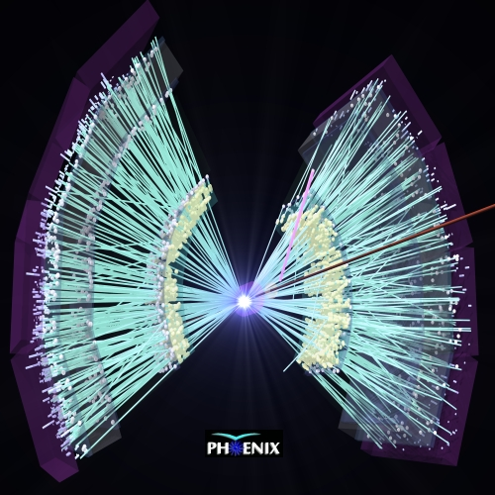
PHENIX experiment at RHIC
Spin physics by polarized proton beam
arXiv:1009.0505 (2010)
QGP physics by heavy-ion beam
Phys. Rev. Lett. 104, 132301 (2010)
http://www.bnl.gov/bnlweb/pubaf/pr/newsroom.asp

Slide 4
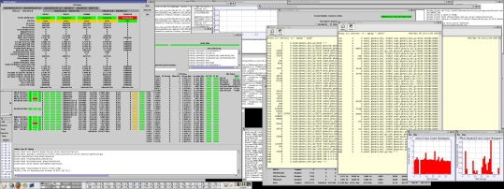
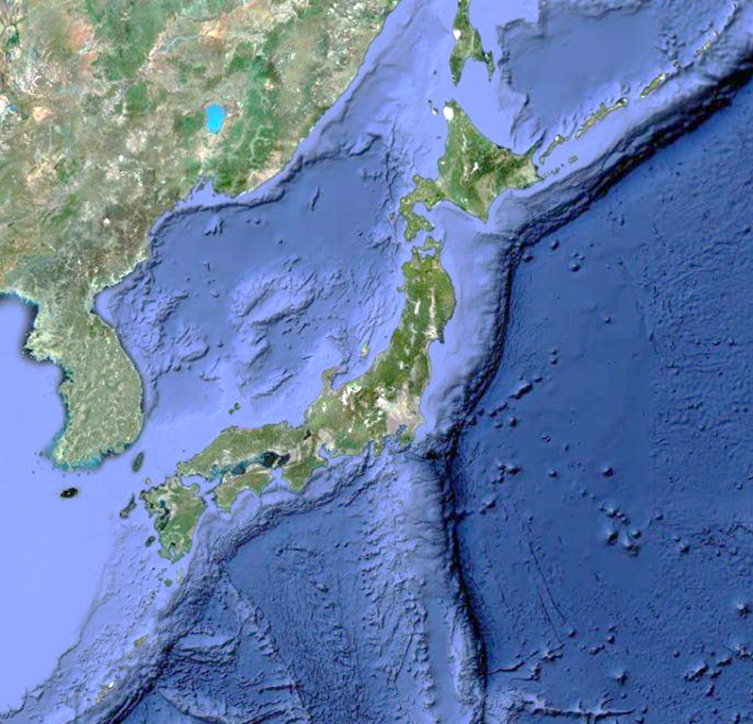
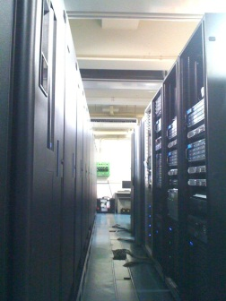
CCJ specification
For the data production:
Network:
10Gbps from BNL to RIKEN (SINET3)
GridFTP servers:
4+2 servers (directly connected with buffer box in PHENIX counting room)
Tape storage:
HPSS 7.1
TS3500 library 2.5PB (Maxim 8PB)
Raw or Reconstructed
Reconstructed
For the user analysis:
PC cluster:
~252core
160core (Joint operation with RIKEN Integrated Cluster of Clusters)
Disk storage:
~320TB
Analysis environments:
Offline library
Data bases
Maintaining equivalent resources since the start of operation (2000).
http://accc.riken.jp/ricc_e.html

Slide 5
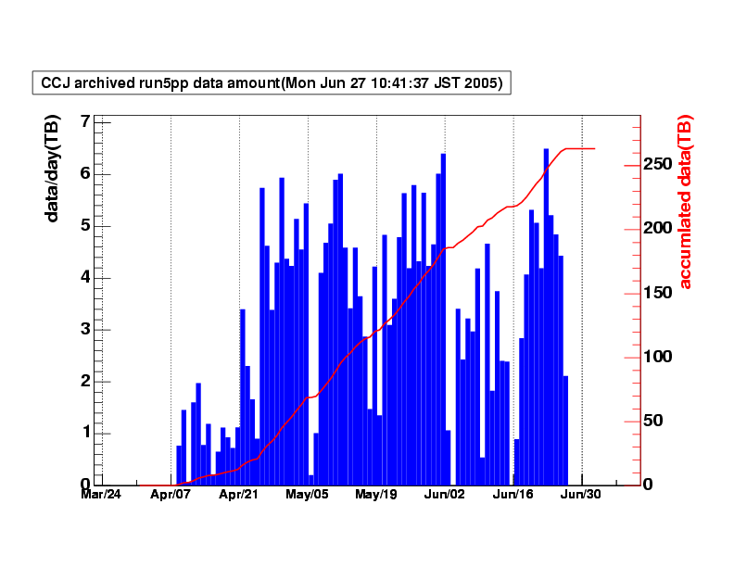
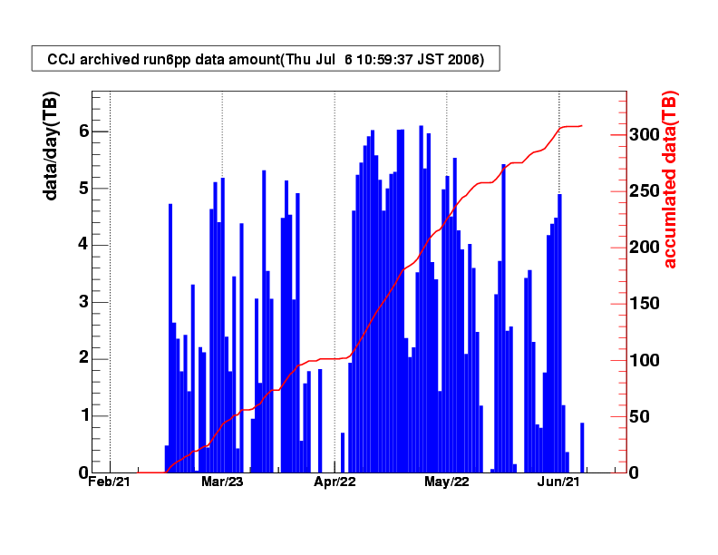
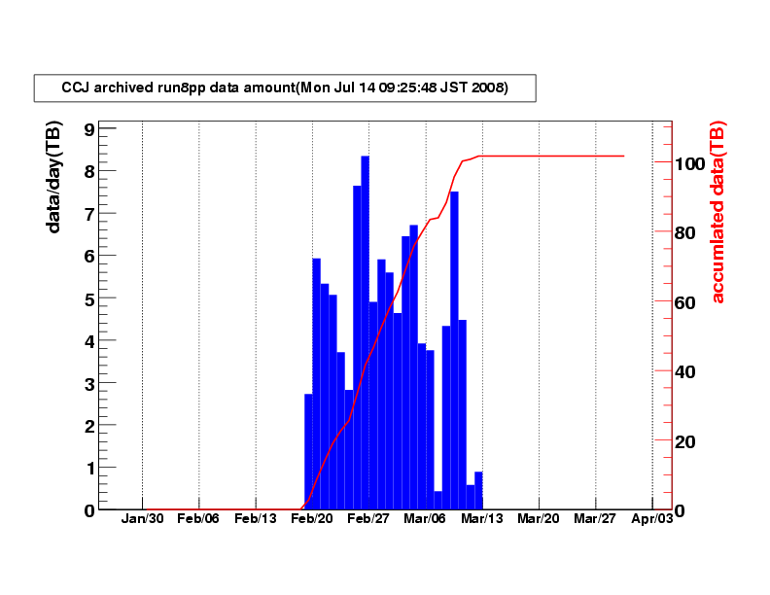
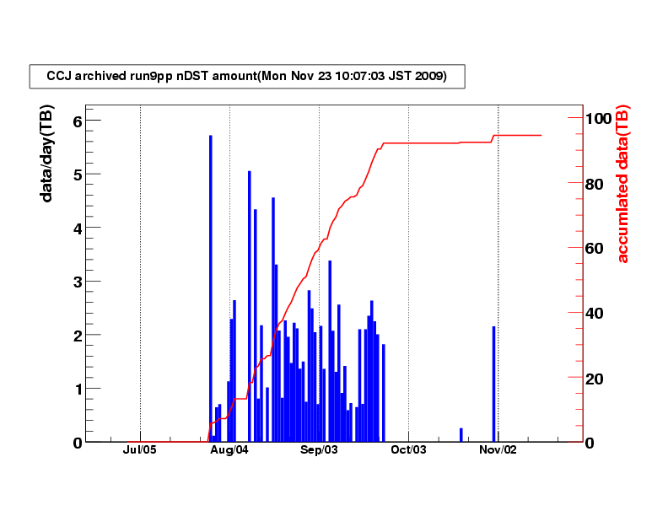
Data transfer record by GridFTP
RHIC-Run5
FY2005
Polarized p+p 200GeV
Raw data
Total 263TB
FY2006
Polarized p+p 200GeV
Raw data
Total 308TB
FY2008
Polarized p+p 200GeV
Raw data
Total 100TB
FY2009
Polarized p+p 200/500GeV
Reconstructed data
Total 95TB
RHIC-Run6
RHIC-Run8
RHIC-Run9
1.5PB of raw and reconstructed data was stored as of 2010.

Slide 6
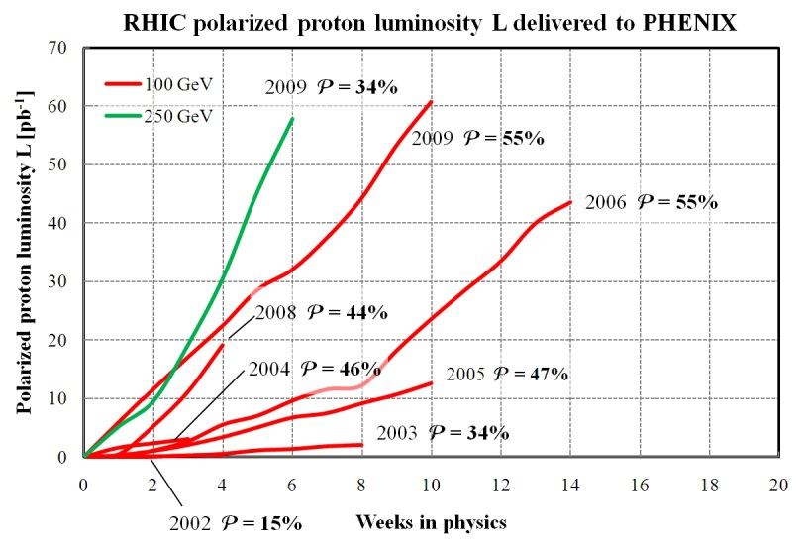
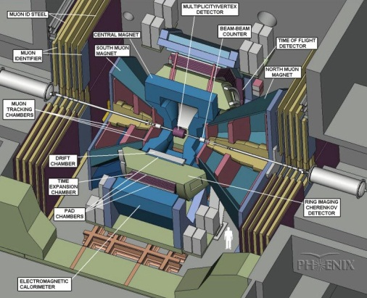
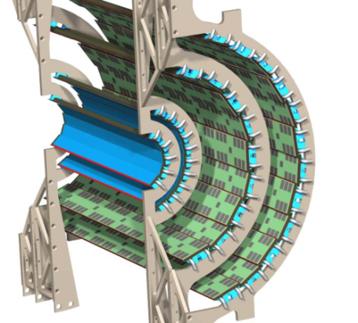
Effective utilization for the user analysis
Growing data size
Improvement of beam at RHIC
Luminosity
Polarization
Detector upgrade:
~400Kch + Silicon VTX 4.4Mch.
DAQ upgrade:
500 ~ 800MB/sec at RHIC-Run10.
Will be upgraded factor 2 or more.
For the user data analysis
Data distribution, storage to many nodes:
Not easy to avoid the I/O bound problem by the conventional methods.
NFS export:
Too slow due to the multiple access.
Disk cash:
No way, when you scan all of the data set.
Minimization of I/O
http://www.bnl.gov/cad/
Silicon VTX
+
Preparing special nodes with large capacity of local disk to store the read only data in advance.
http://www.rarf.riken.go.jp/lab/radiation/

Slide 7
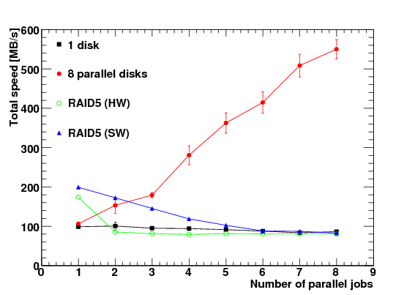
Disk configuration and I/O performance
HP ProLiant DL180 G5
Chassis: 2U, 12HDD-bay
CPU: Quad-core × 2
2.66GHz Xeon E5430
Memory: 16GB (RDIM)
HDD:
146GB SAS × 2 for the system (RAID1)
1TB SATA × 10 for the data storage
NIC: 1Gbps
Uplinked by 10Gbps switch in rack.
System
OS: Scientific Linux 5.3 x86_64
File system: ext3
XFS has no gain for the read only usage.
HDD configuration
RAID5 configuration:
Advantage is only for 1 process.
Good performance without RAID:
Total ~550MB/sec at 8 parallel jobs.

Slide 8
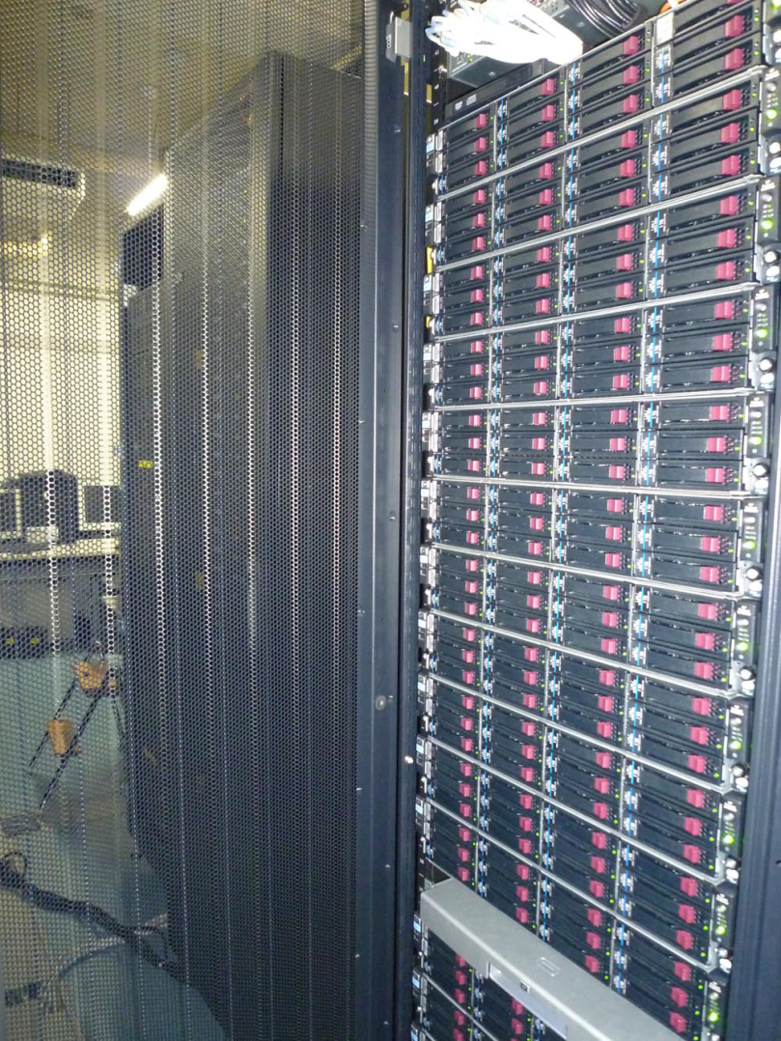
Data allocation
PC Cluster
Total 18 nodes
Total 144 CPU cores
Total 180TB for the data storage
Data sets in HDD
Every HDD has a part of each data set segmented by run number.
User jobs can use all of CPU cores without time loss at data distribution.
~40GB work area is allocated in each HDD for the non data analysis jobs e.g. simulation.
1TB
1TB
Run9
1TB
Run9
Run8
1TB
Run9
Run8
Run6
Run9
Run8
Run6
Run5
Run8
Run6
Run5
Work area
Run6
Run5
Work area
Run5
Work area
Work area

Slide 9
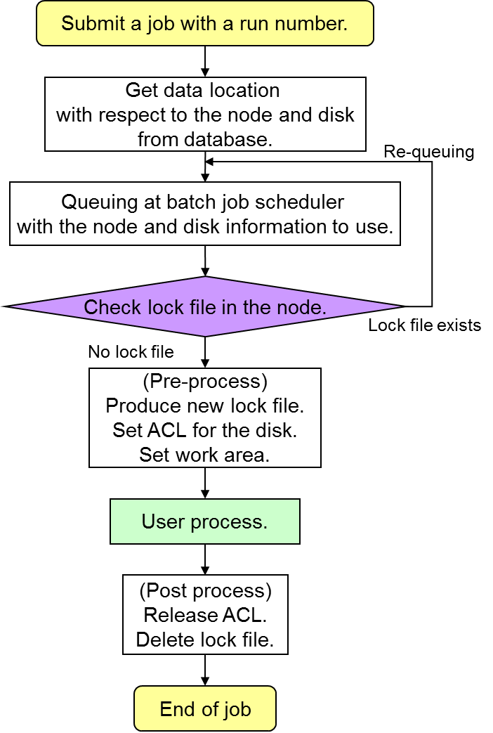
Job submission scheme
Job submission script
Submit the user job to the appropriate node automatically, which has the required data.
Batch Job scheduler (LSF 7.0)
Fair-share among users.
Set the path to the data directory and work area for environmental variables in the job.
Lock file and directory ACL
Create at the pre-process for the exclusive use of a physical disk.
Second job, which will use the data in occupied disk by the first job, stay in queue until the end of the first job.
User got to be able to analyze all of the existing data in local HDD (150TB) within 9 hours.
LSF

Slide 10
Summary
18 calculating nodes with 180 TB local disks were introduced for effectively analyzing huge amounts of PHENIX data.
A data-oriented batch queuing system was developed as a wrapper of the LSF system to increase the total computing throughput. Indeed, the total throughput was improved by roughly 10 times as compared to that in the existing clusters; CPU power and I/O performance are increased threefold and tenfold, respectively. Thus, users can analyze data of 150TB within 9 hours.
We have experienced just 2 times disk failure out of 180 disks in 1.5 years operation. Therefore, we could conclude that this method is highly effective for the I/O bound data analysis.

Slide 11
Next step
Preparing the same set of cluster with same data set,
High availability:
Reducing down time by the redundant data.
Balance of job distribution with respect to any kind of jobs.
Easy to expand for the growing data size:
Without any other special software.
No special servers and no additional HW components except for the cluster.
By low cost:
144CPU core, 2GB memory/core, 180TB disk for the local data storage.
~$150K as of 2009.
The capacity of a HDD is growing and its price is going down steadily.

Slide 12
Backup

Slide 13
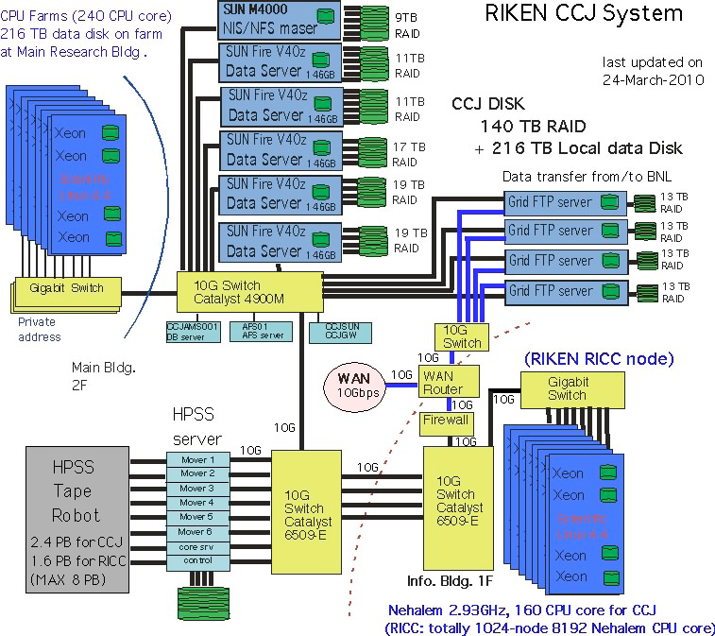
CCJ specification
Riken Integrated Cluster of Clusters:
http://accc.riken.jp/ricc_e.html

Slide 14
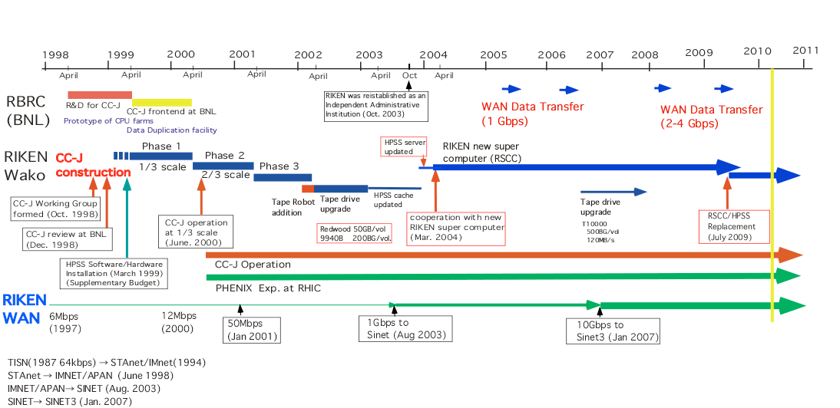
CCJ history

Slide 15
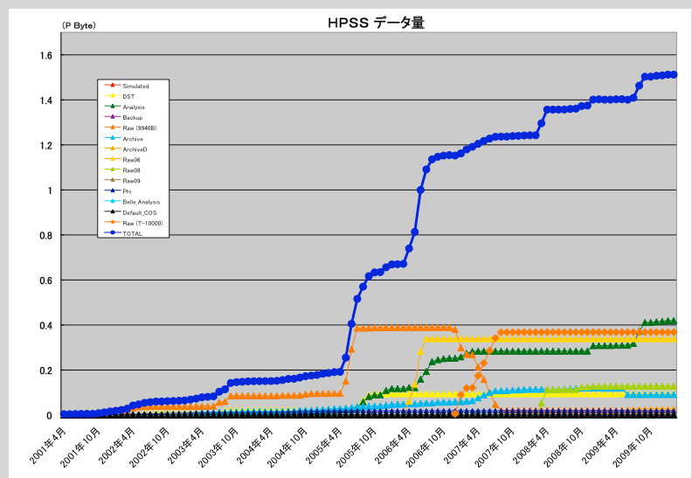
HPSS data amount

Slide 16
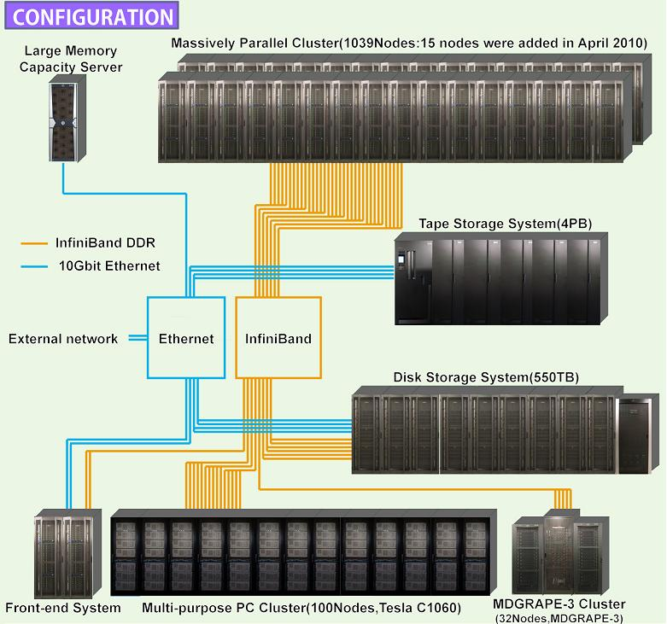
RIKEN Integrated Cluster of Clusters
http://accc.riken.jp/ricc_e.html

Slide 17
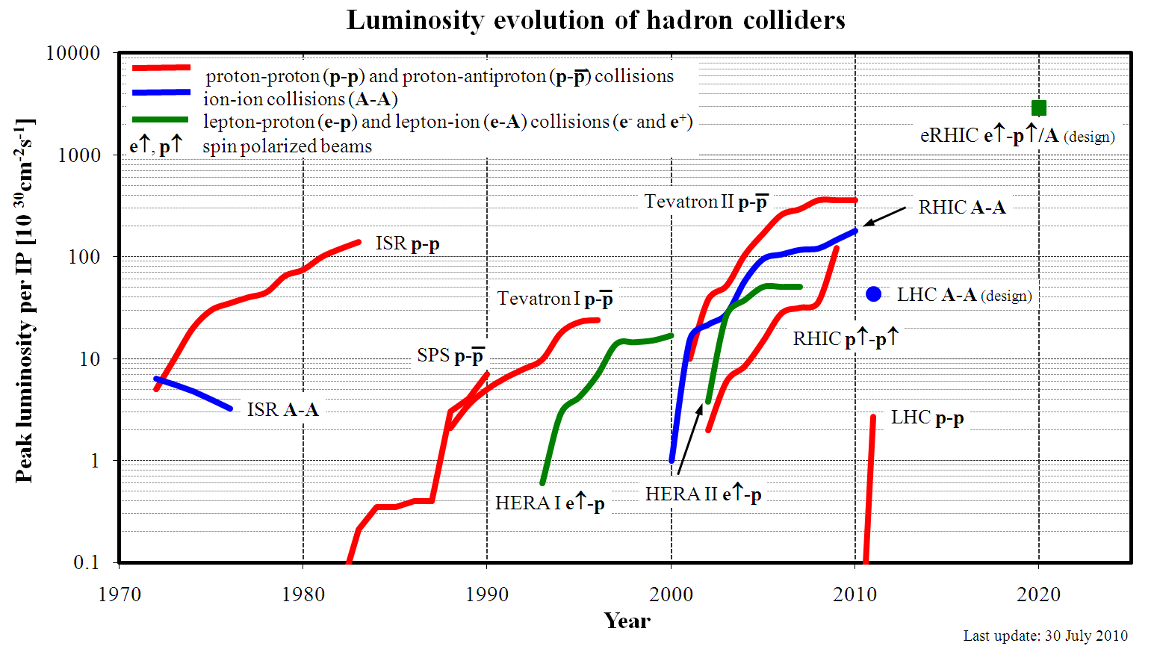
Luminosity at hadron collider
http://www.bnl.gov/cad/

Slide 18
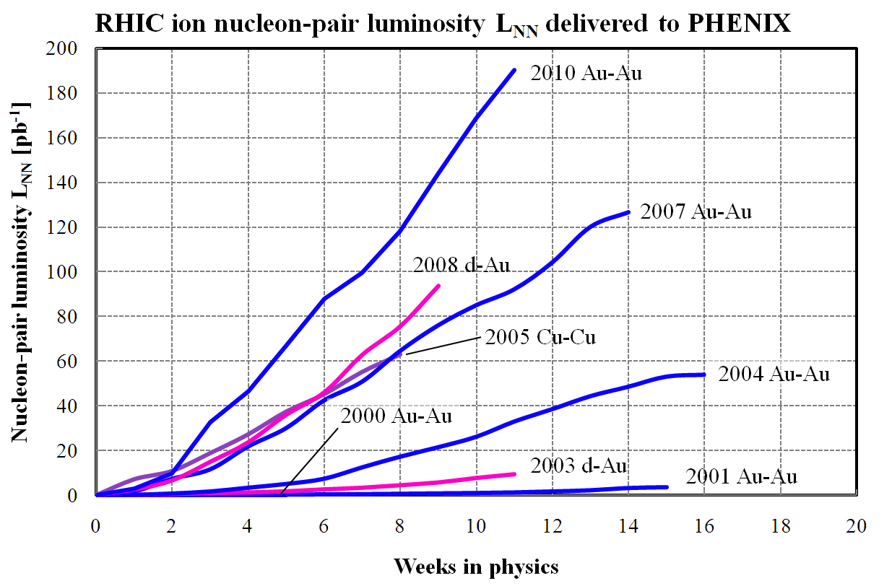
Integrated luminosity A+A at RHIC
http://www.bnl.gov/cad/

Slide 19
PHENIX DAQ upgrade
SuperDAQ
(i.e. sDAQ)
DAQ2010
James Nagle: Next Decade Plans for the PHENIX Experiment
Workshop on Saturation, the Color Glass Condensate and Glasma

